Slide 1
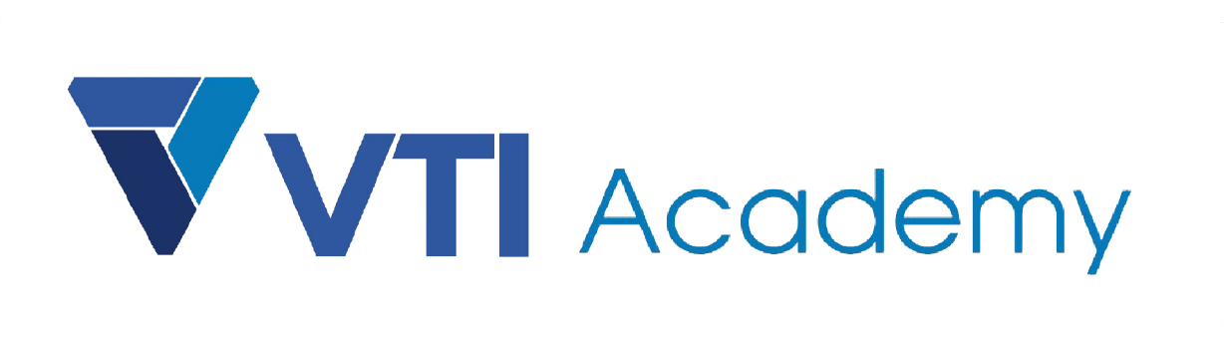
WAY TO ENTERPRISE
AWS
VTI ACADEMY
Author: duy.nguyenngoc1@vti.com.vn

Slide 2
Agenda
VPC Service
Assignments
Quiz
Copyright © VTI Academy All Rights Reserved

Slide 3
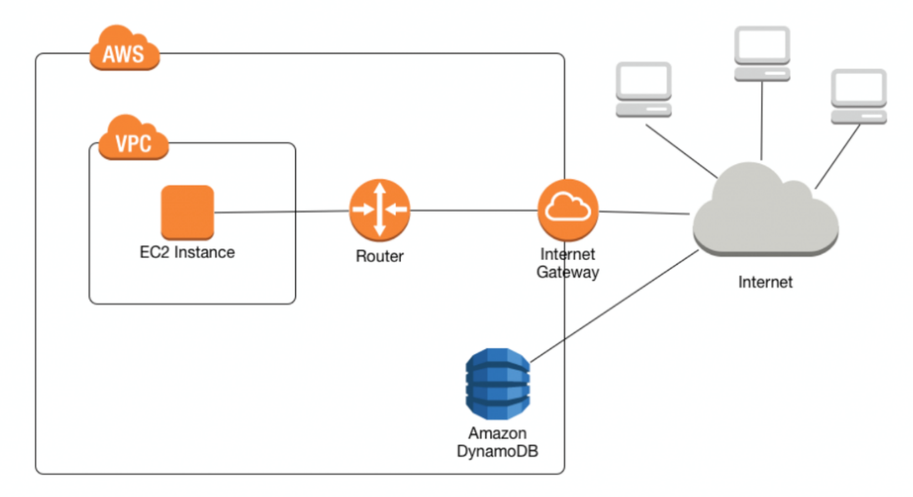
VPC Service
Stands for Virtual Private Cloud
Networking Service, Regional service
Is a virtual network on AWS Cloud, completely separate from the physical network
Price: https://aws.amazon.com/vpc/pricing
https://docs.aws.amazon.com/vpc/latest/userguide/what-is-amazon-vpc.html

Slide 4
VPC Service
Demo
Create VPC
Add subnets
Config public subnets
Launch instance into public subnets
Config private subnets
Launch instance into private subnets

Slide 5
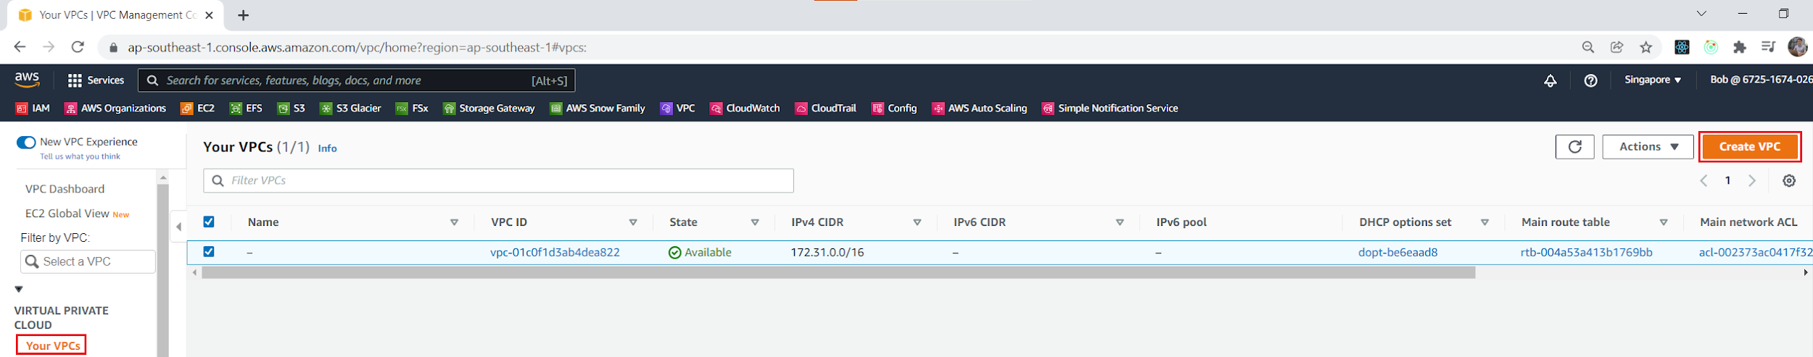
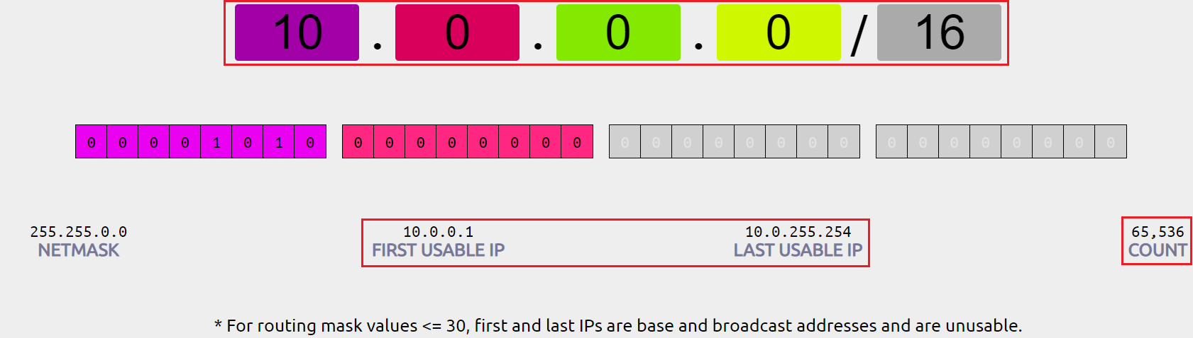
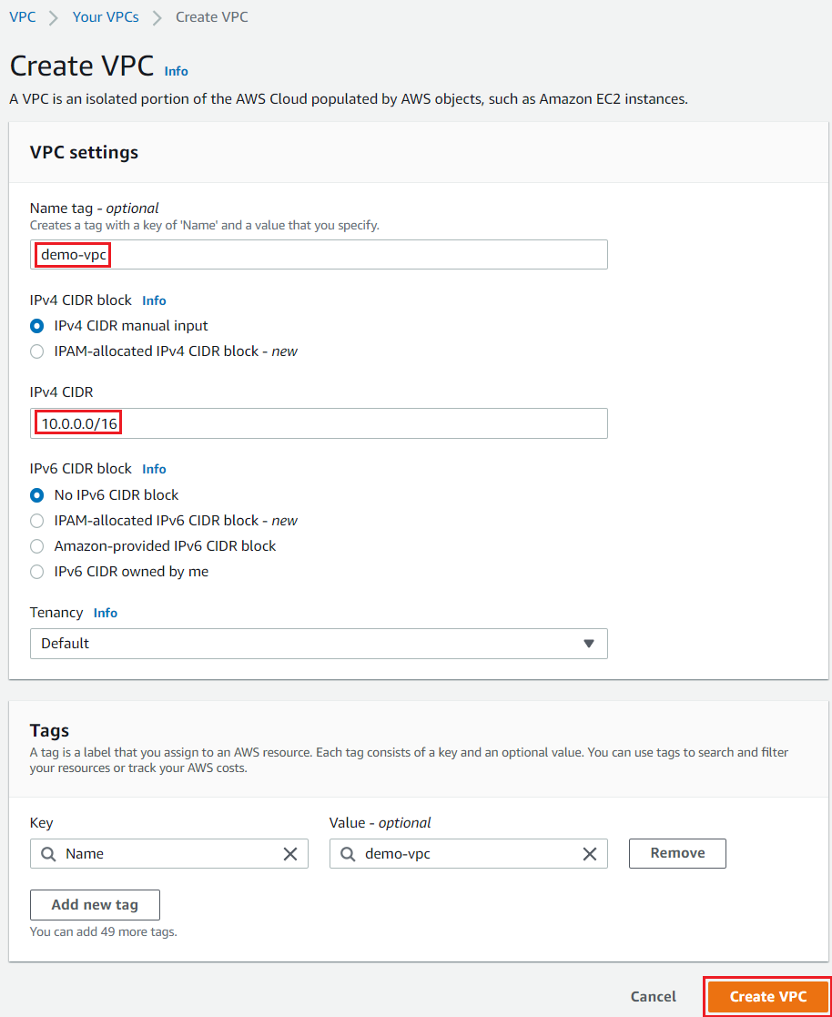
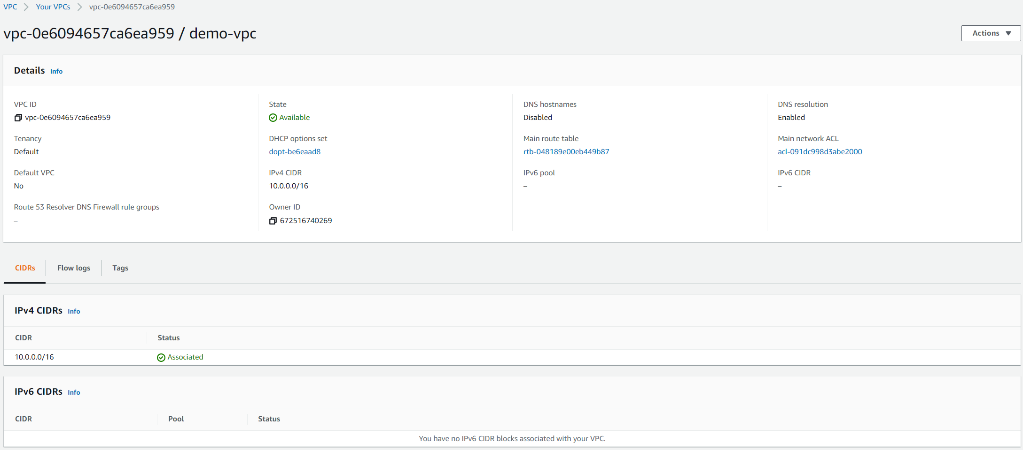
VPC Service
Create VPC
https://cidr.xyz

Slide 6
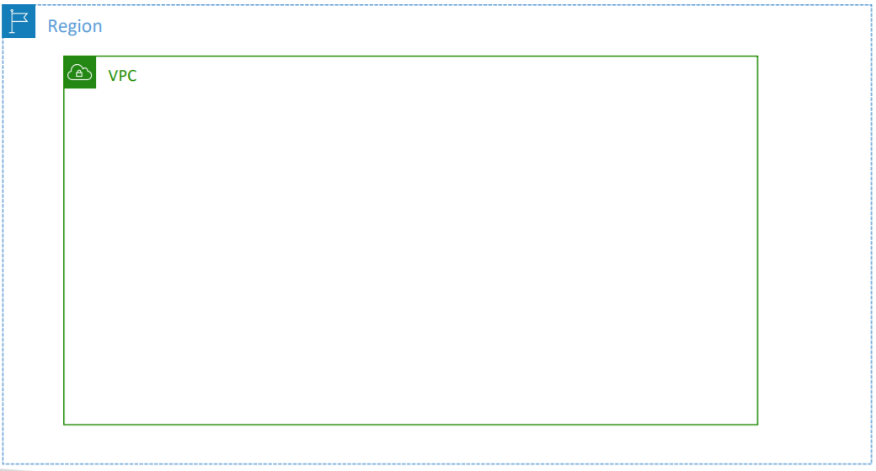
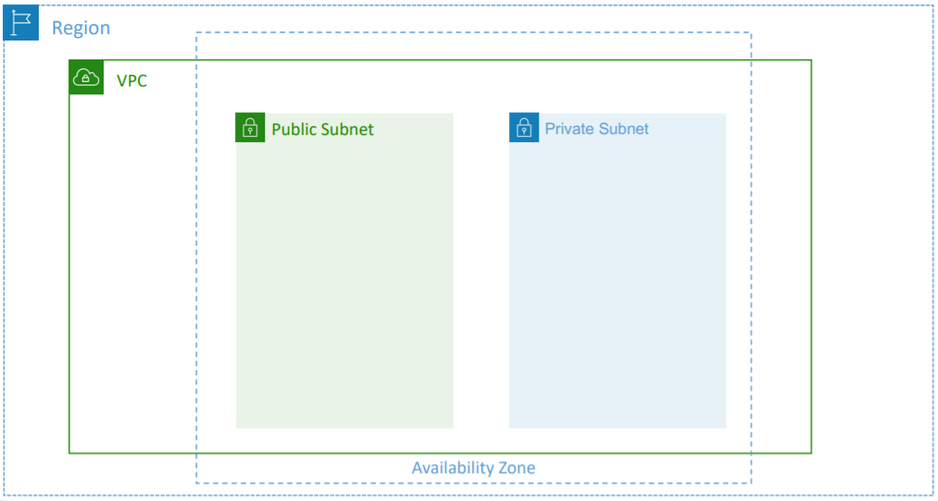
VPC Service
Add subnets

Slide 7
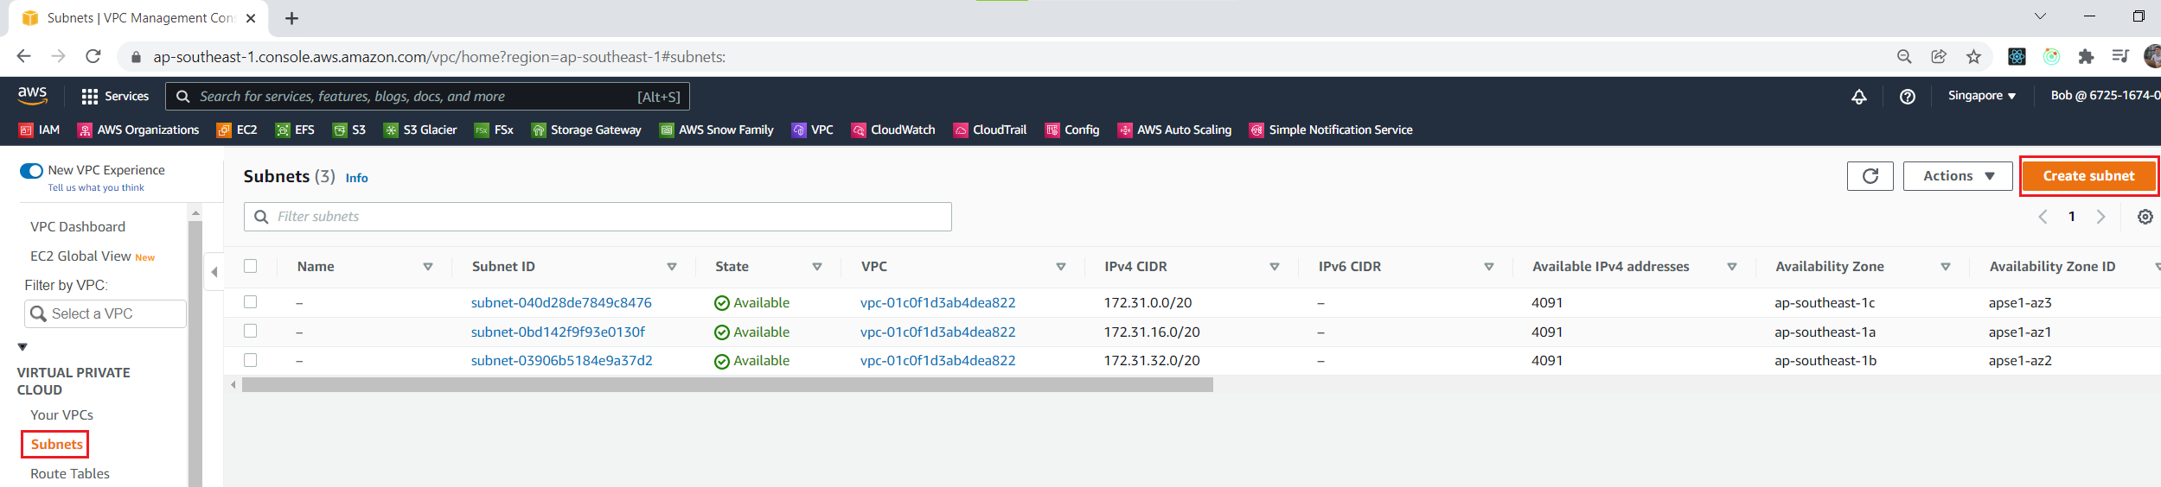
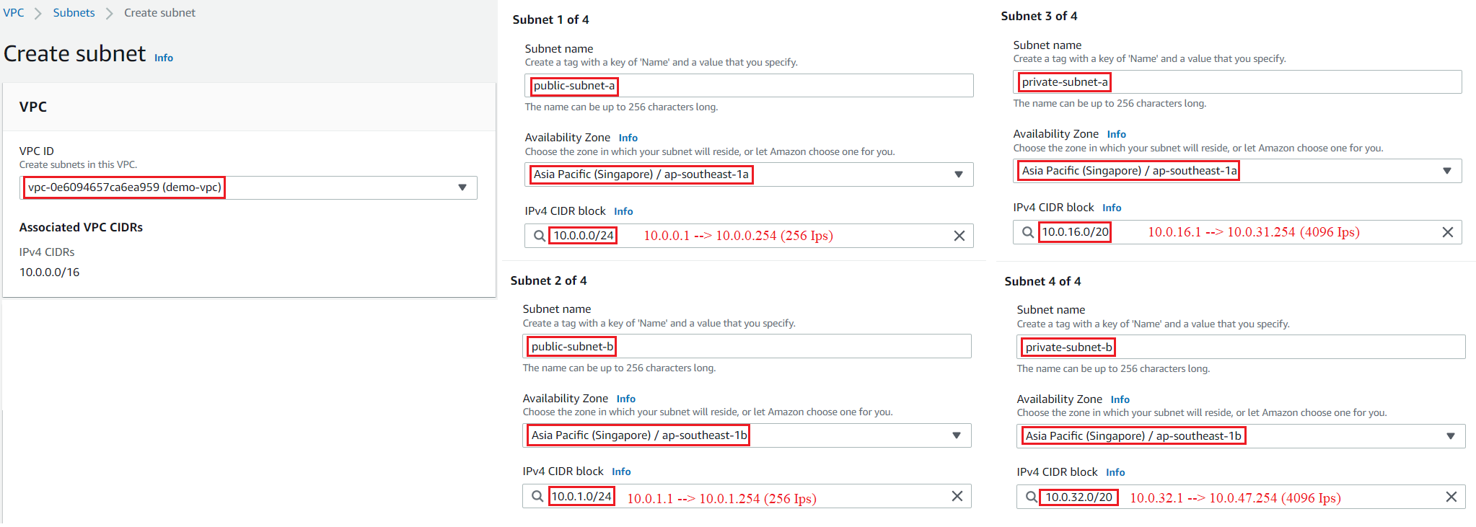
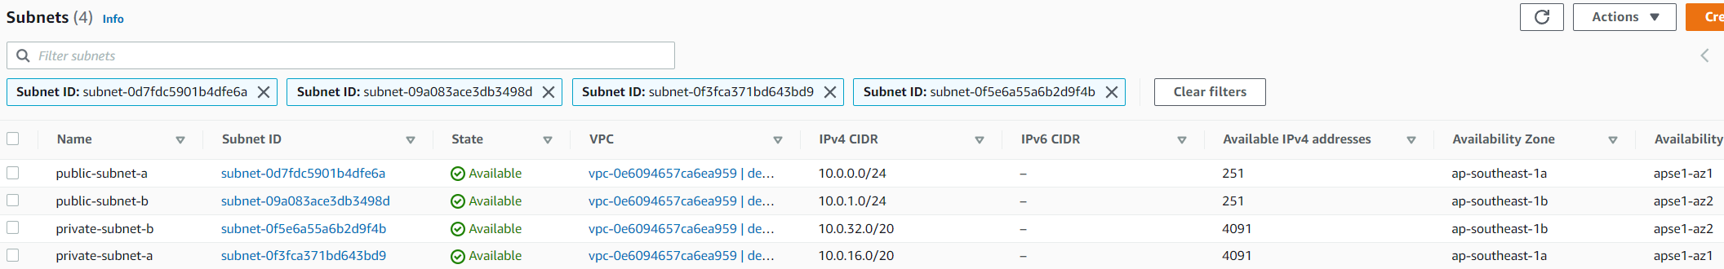
VPC Service

Slide 8
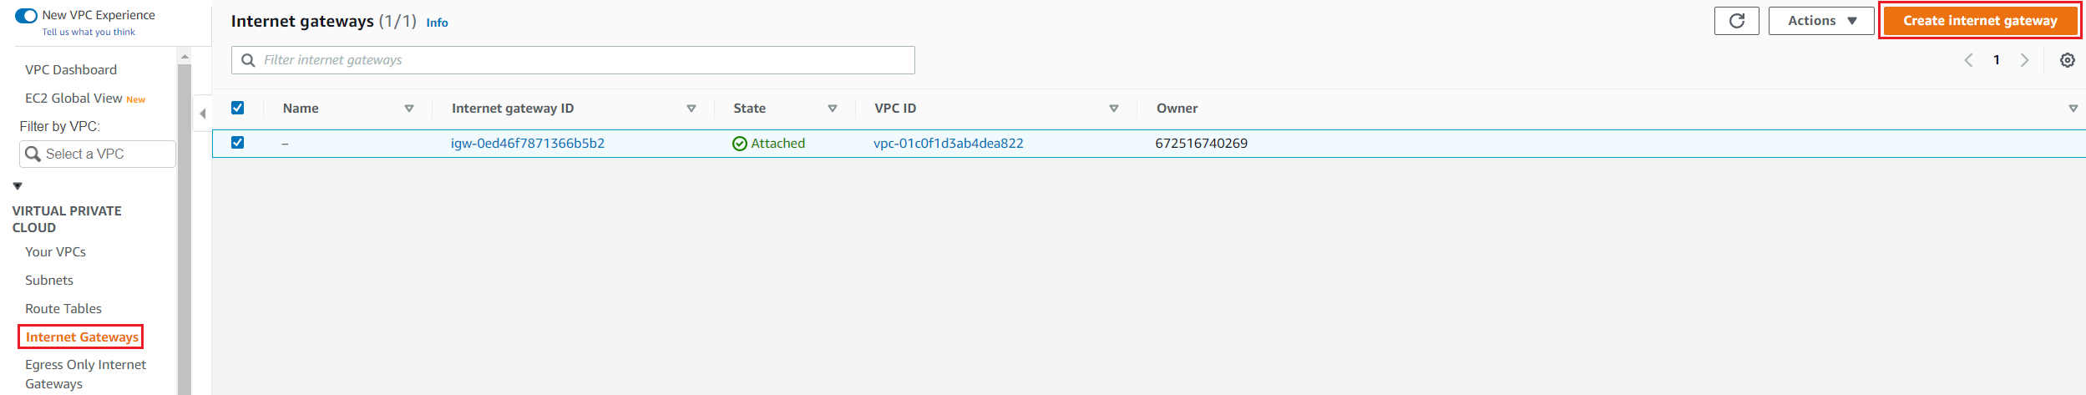
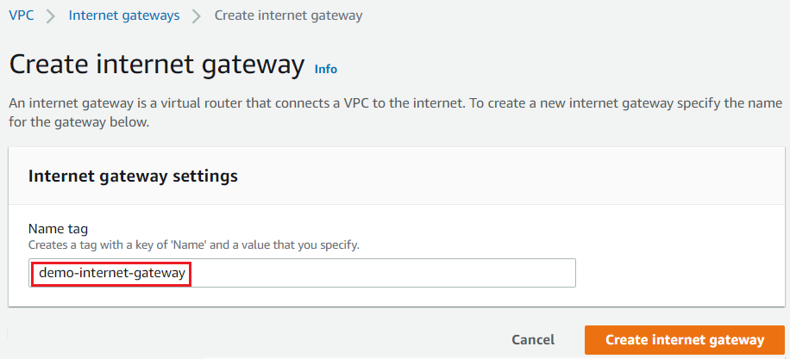
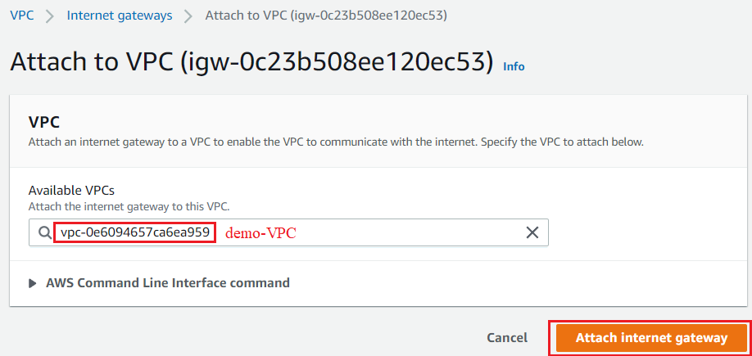
VPC Service
Config public subnets
Create & Attach Internet Gateway to VPC

Slide 9
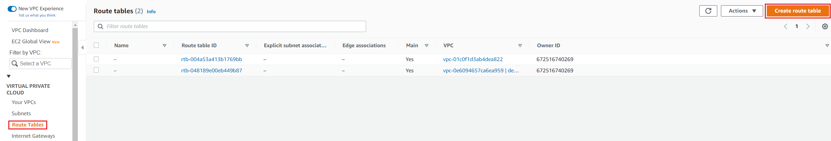
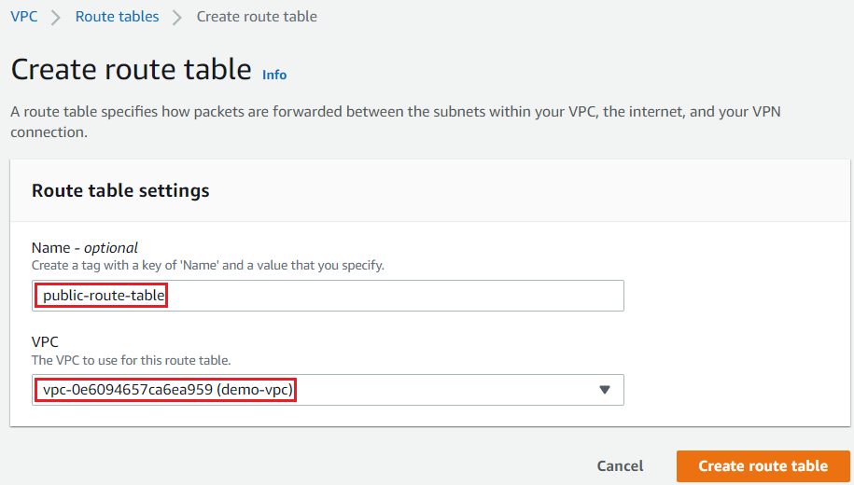
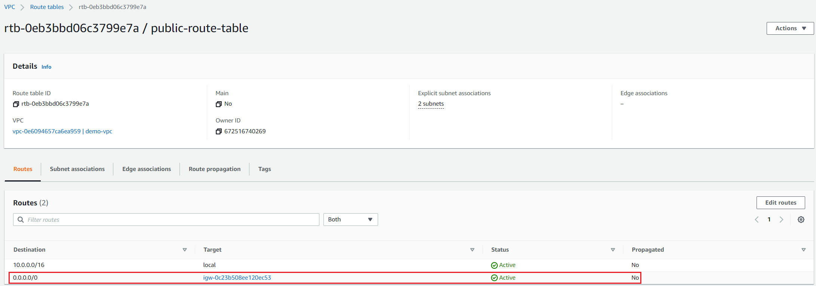
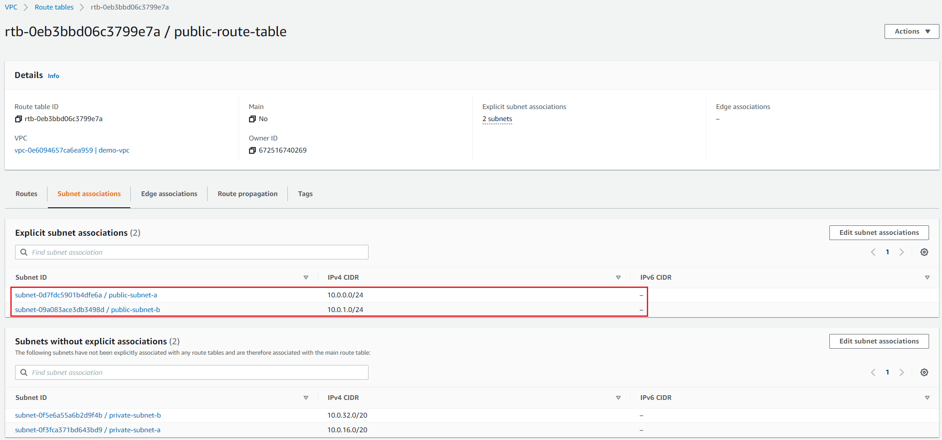
VPC Service
Public Route Table

Slide 10
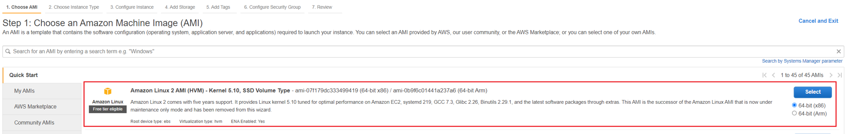
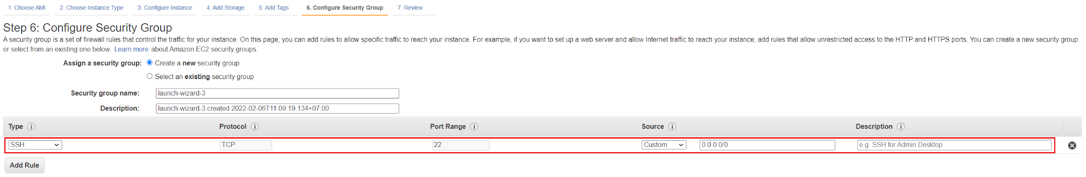
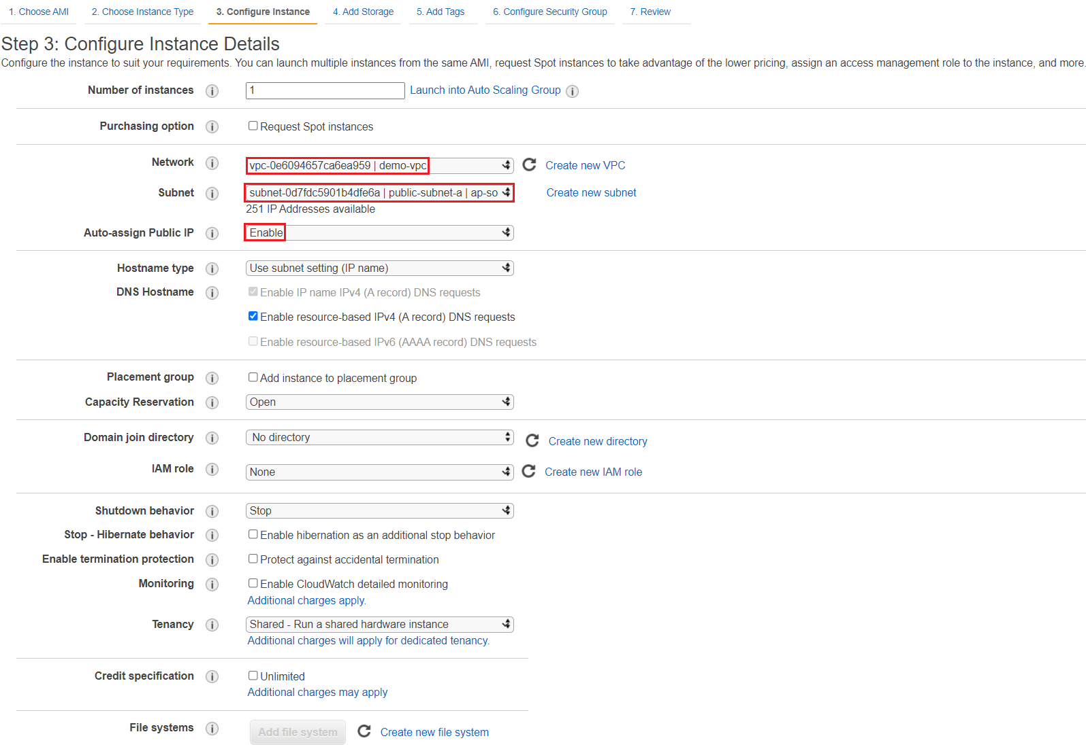
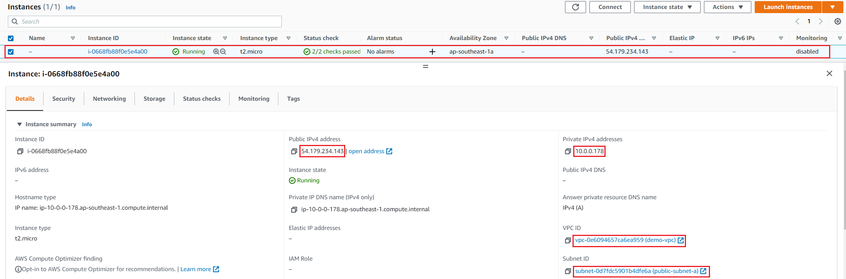
VPC Service
Launch instance into public subnets

Slide 11
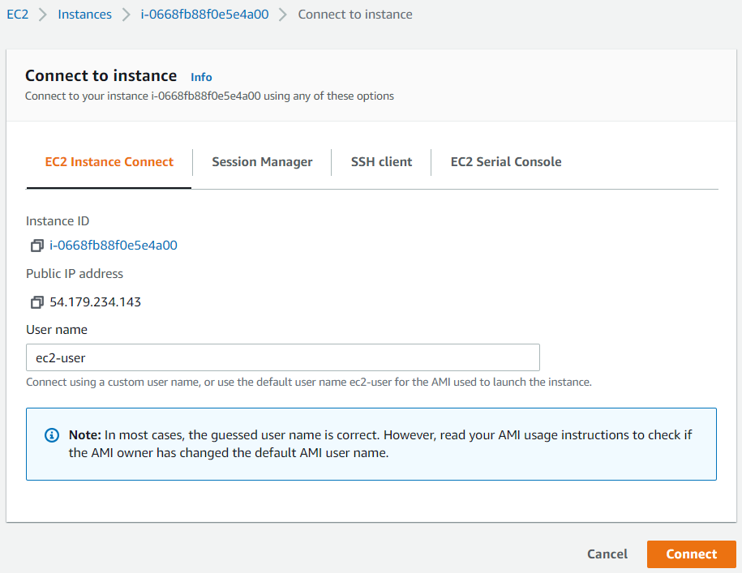
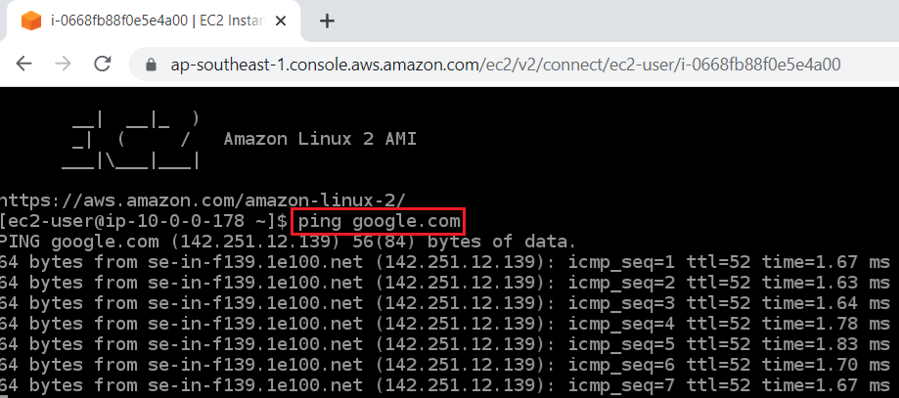
VPC Service
Connect to instance

Slide 12
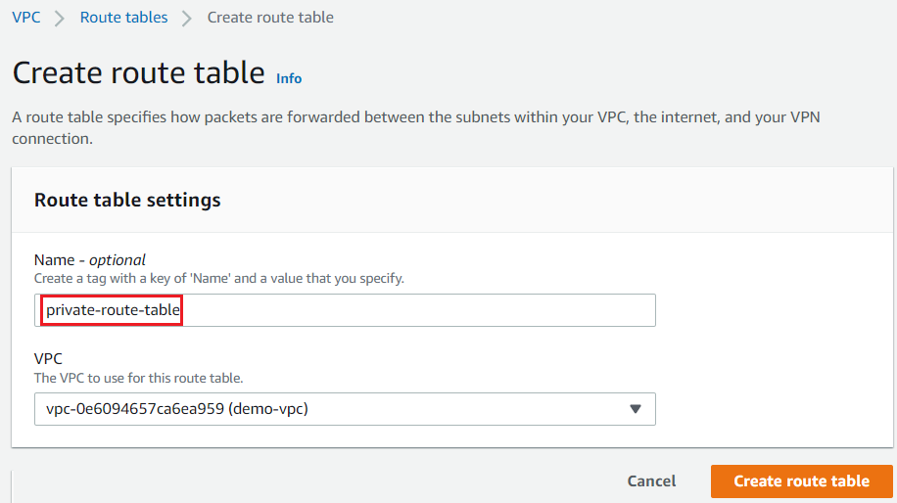
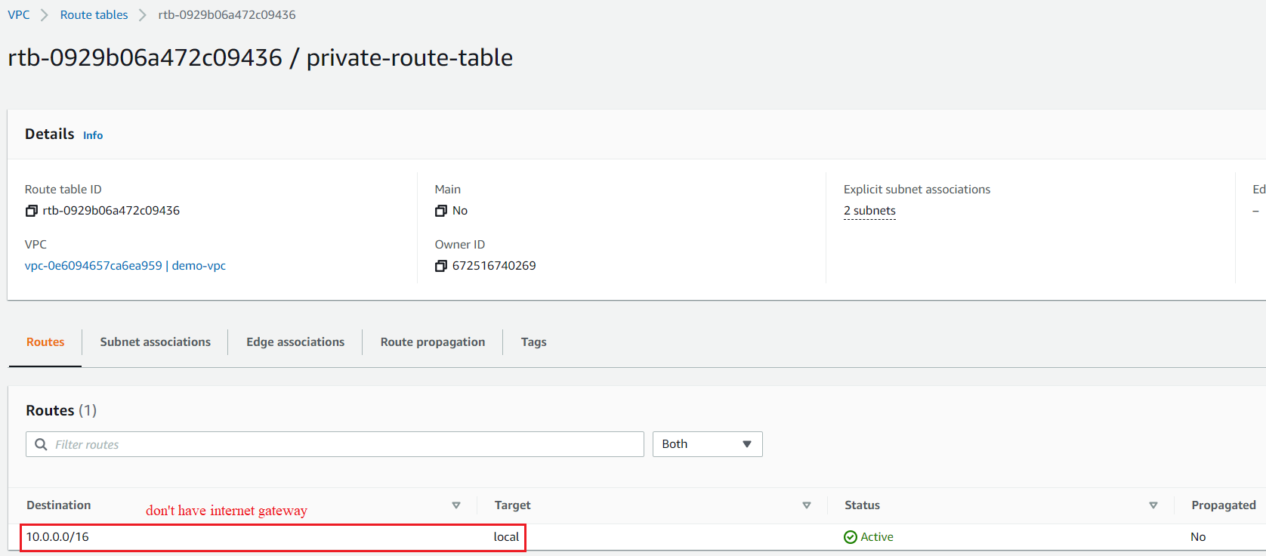
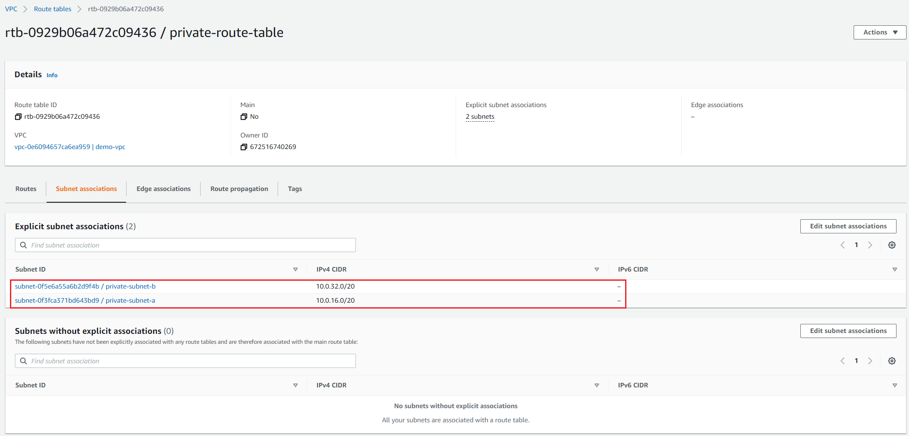
VPC Service
Config private subnets
Private Route Table

Slide 13
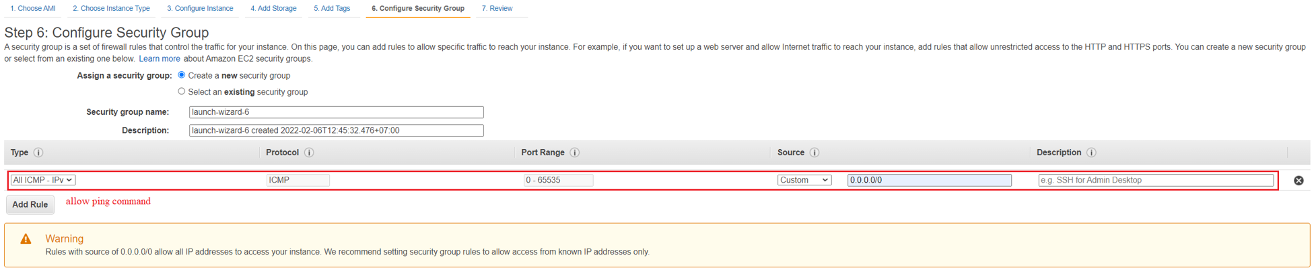
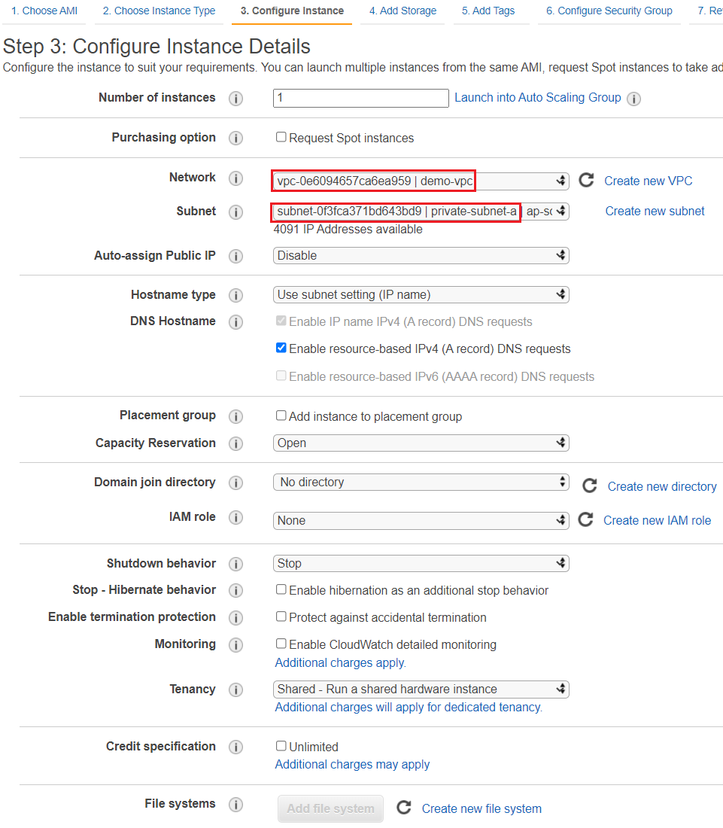
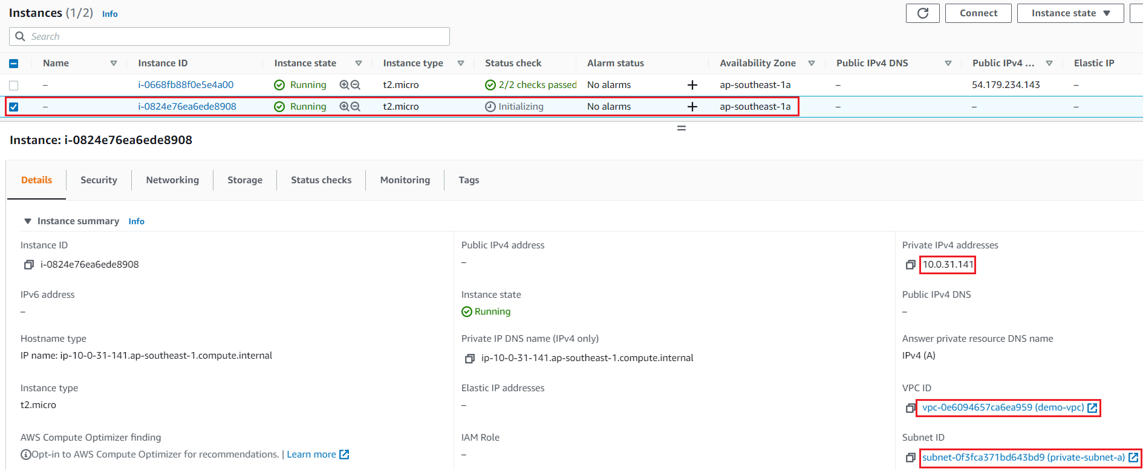
VPC Service
Launch instance into private subnets

Slide 14
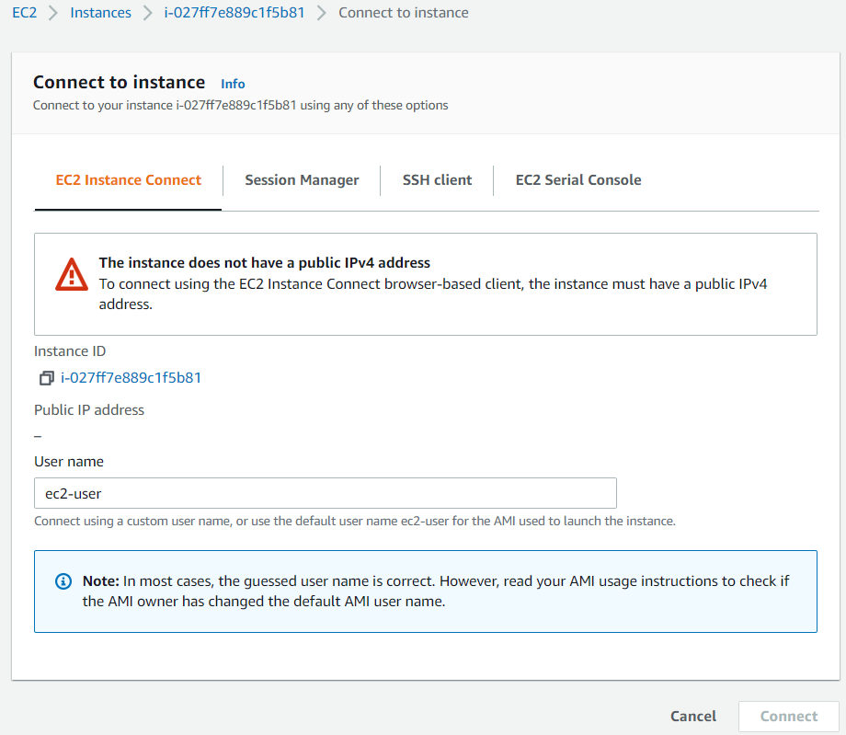
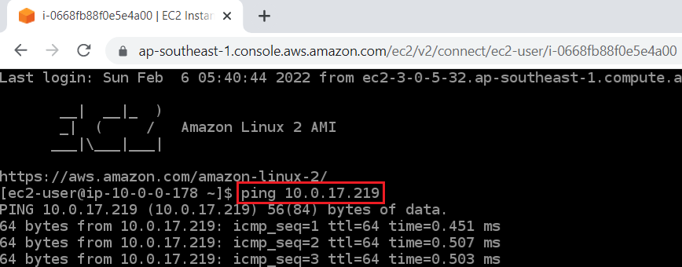
VPC Service
Ping private subnet instance from public subnet instance
Cannot connect to instance

Slide 15
Assignment
Self-practice

Slide 16
VPC Service
Components
VPC
CIDR block
Subnet
Route tables
NACL
Internet gateway
NAT, Egress-only internet gateway
Bastion host, Session Manager
VPC Peering Connection
PrivateLink
VPN
Direct Connect
Transit Gateway
RAM
Global accelerator
Flow Logs
Reachability Analyzer

Slide 17
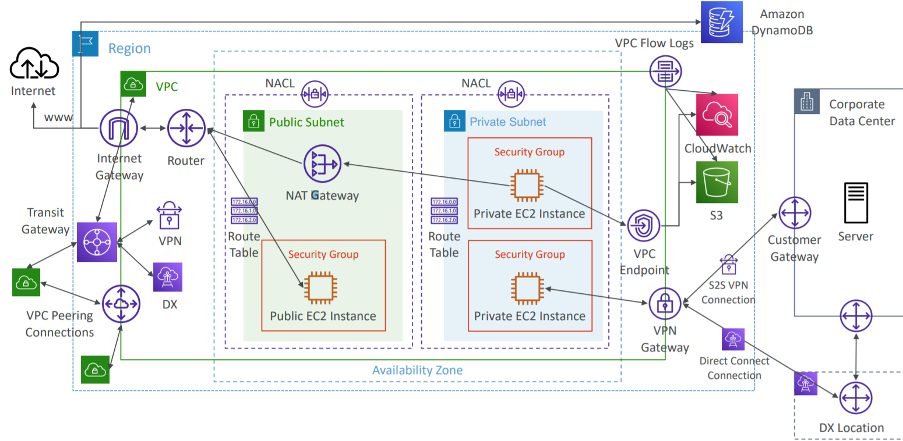
VPC Service

Slide 18
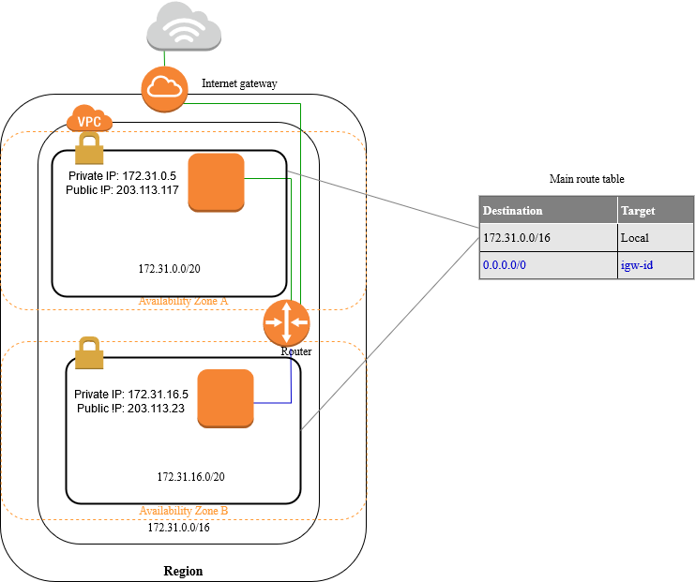
VPC Service
VPC
Allow launching resources in 1 VPC (virtual network)
Ex: launch EC2 in VPC
Allow to create subnet inside VPC
Regional resource
Default using Ipv4
Max 5 VPC per regions
Can share components in VPC for other accounts (bill is still charged to the owner)

Slide 19
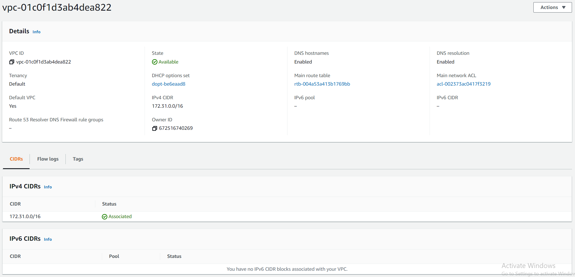
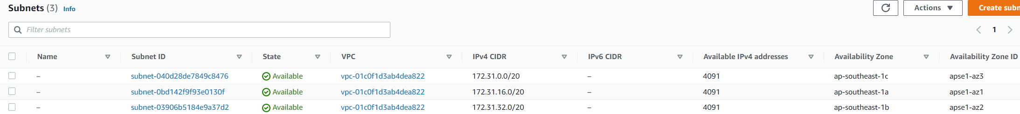
VPC Service
Default VPC
Set up public subnets, public ipv4 for instance, internet gateways, route tables, ...
Can modify the components inside
https://docs.aws.amazon.com/vpc/latest/userguide/default-vpc.html
Can extend VPC to other regions
https://docs.aws.amazon.com/vpc/latest/userguide/Extend_VPCs.html
Default VPC
Default subnets

Slide 20
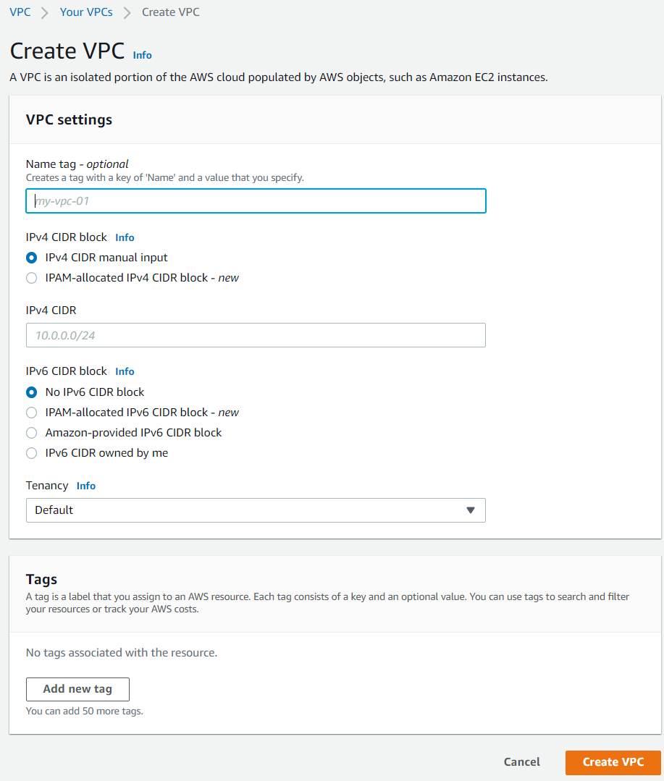
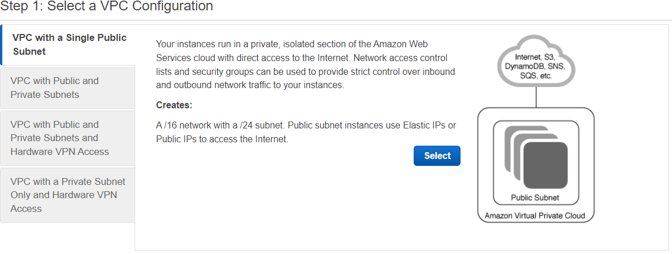
VPC Service
2 ways to create
Manual
Wizard
Wizard
Manual

Slide 21
VPC Service
Usecases
VPC & 1 public subnet & 1 internet gateway: IpV4, Ipv6
VPC with public and private subnets (NAT): Link
VPC with public and private subnets and Site-to-Site VPN access: Link
VPC with a private subnet only and Site-to-Site VPN access: Link

Slide 22
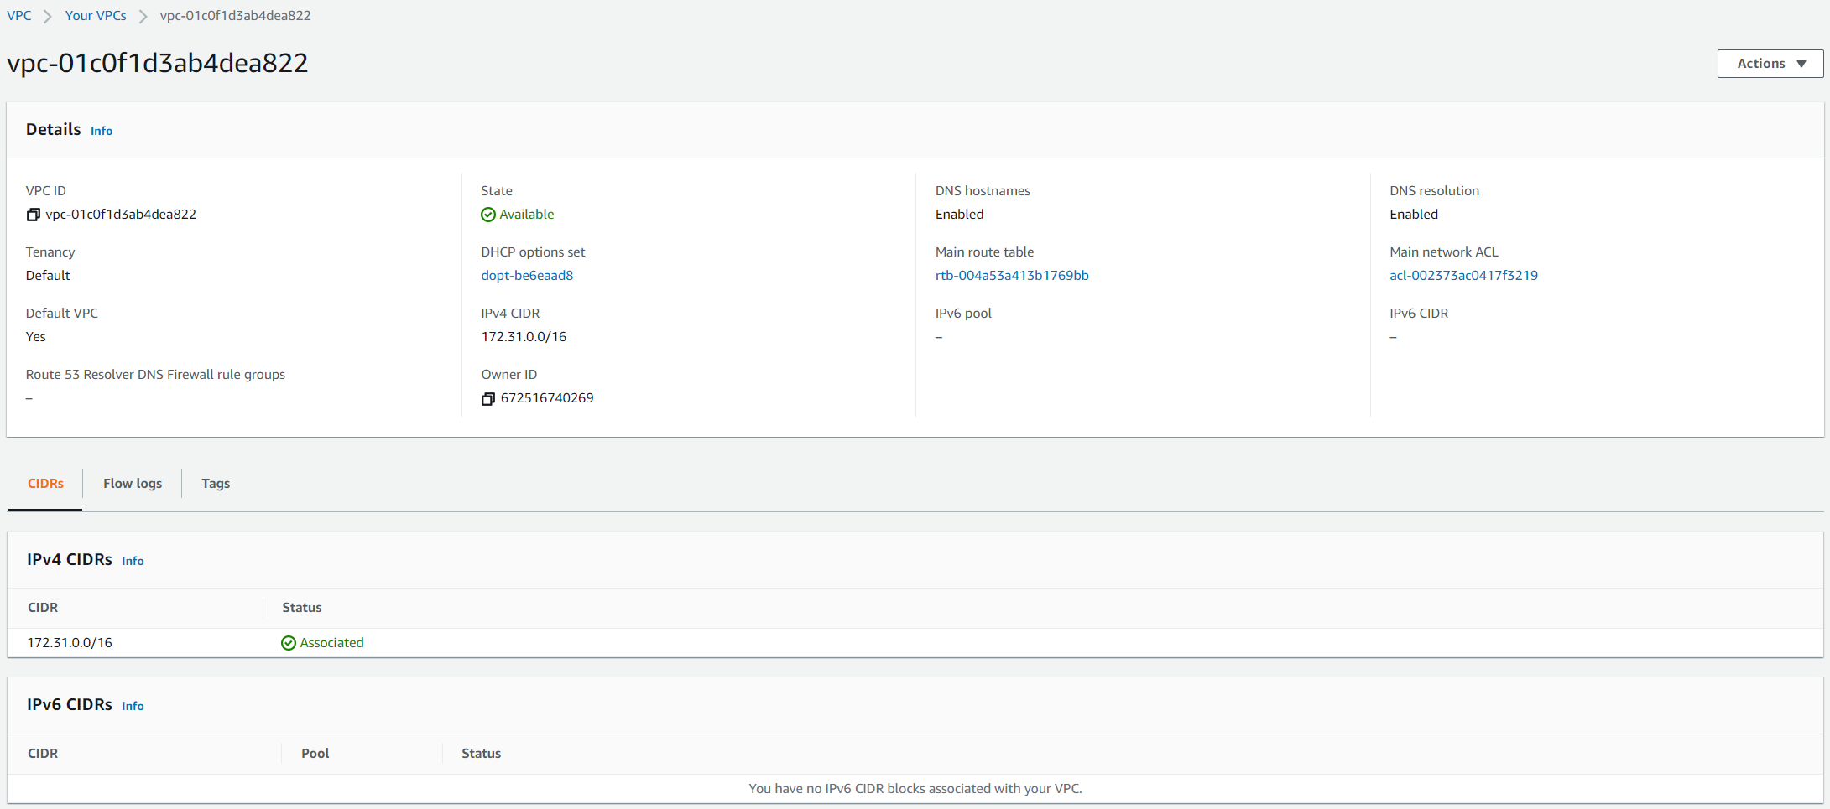
VPC Service
Components

Slide 23
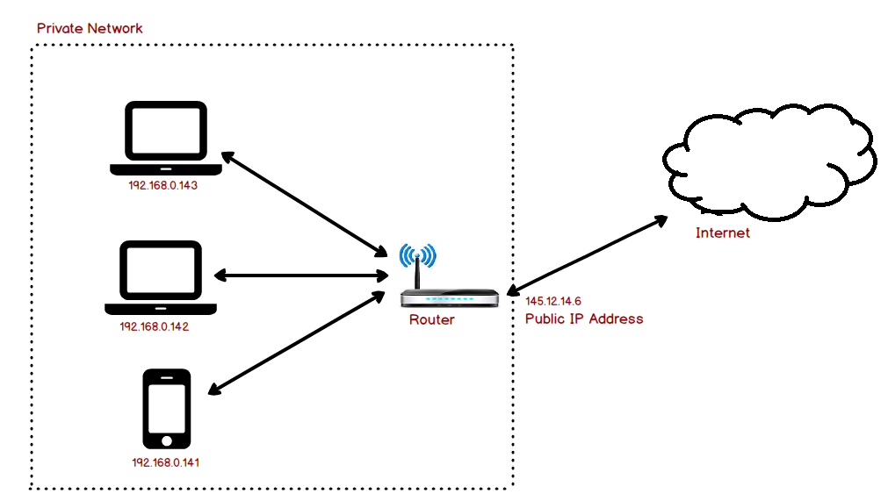
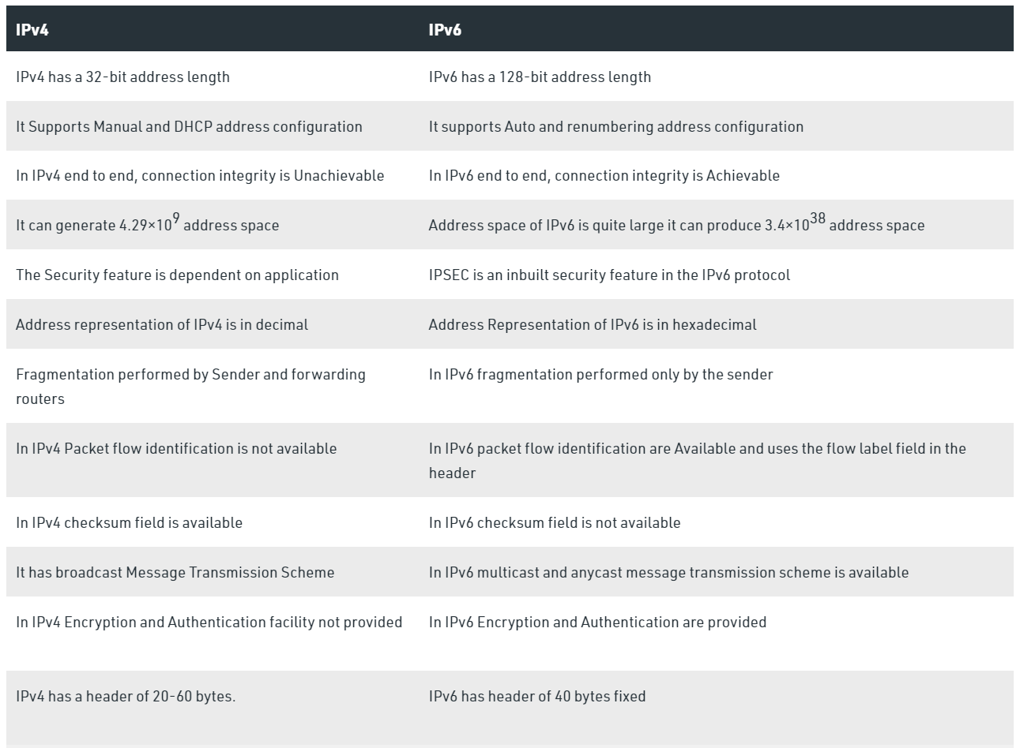
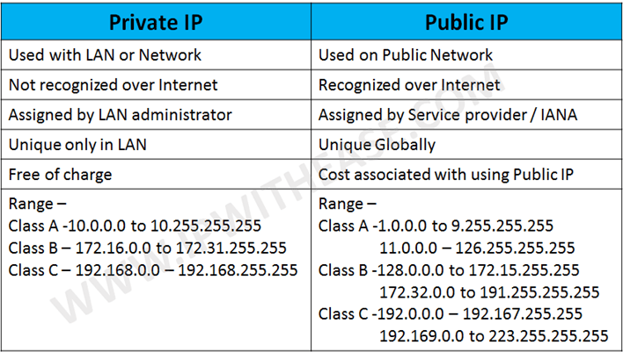
VPC Service
Ipv4 & Ipv6
https://www.guru99.com/difference-ipv4-vs-ipv6.html

Slide 24
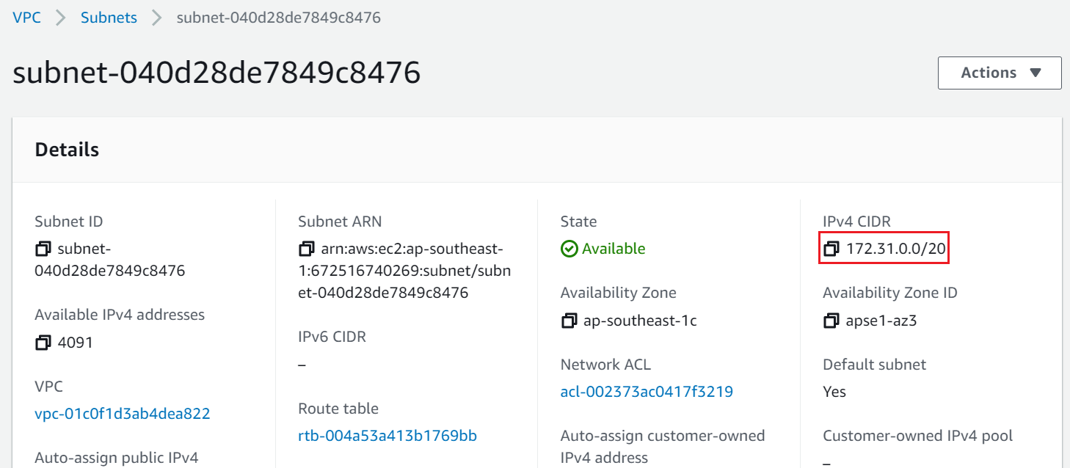
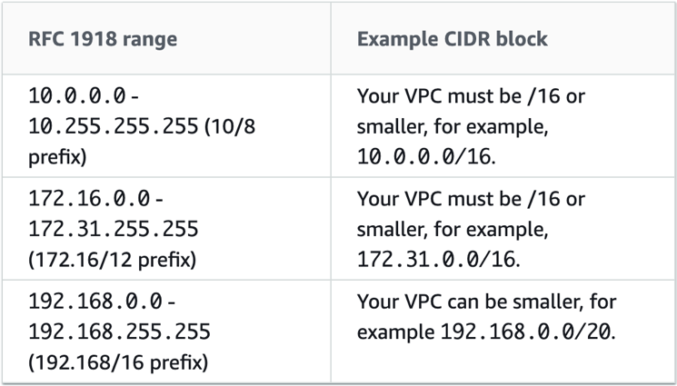
VPC Service
CIDR block
Stands for Classless Inter-Domain Routing block
Is a method for allocating IP addresses
Is a range of private IP
Max 5 CIDR Block per VPC
Including: private IP & Netmask
Ex: 192.168.0.0/28 – IP: 192.168.0.0 & Netmask = /28
Support Ipv4 & Ipv6

Slide 25
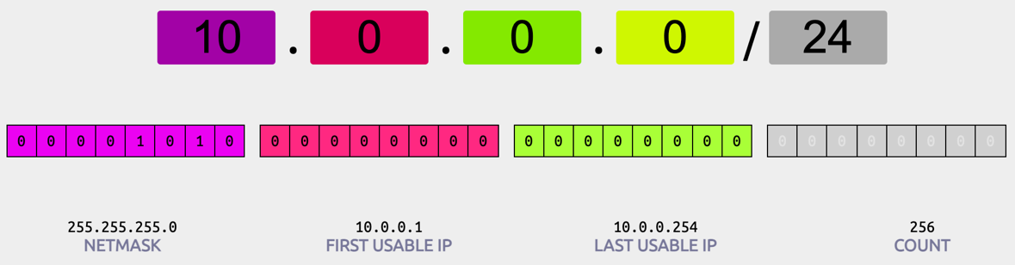
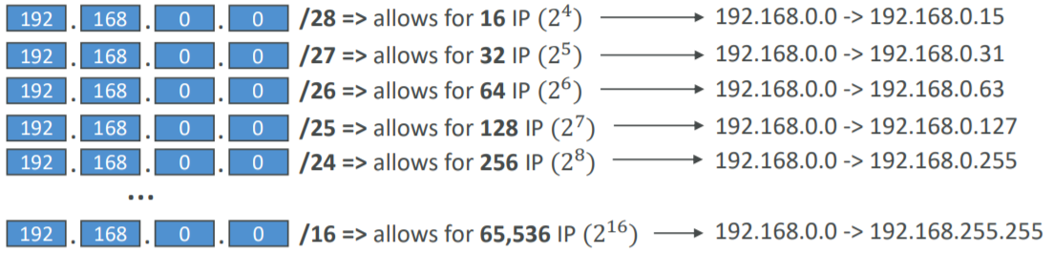
VPC Service
Example 1:
10.0.0.0/28 🡺 There is 2^4 = 16 IPs in subnet
10.0.0.0/24 🡺 There is 2^8 = 256 IPs in subnet
10.0.0.0/16 🡺 There is 2^16 = 65536 IPs in subnet
Tools Ipv4 – Tool 1, Tool 2
Tools Ipv6 - Tool
Example 2:

Slide 26
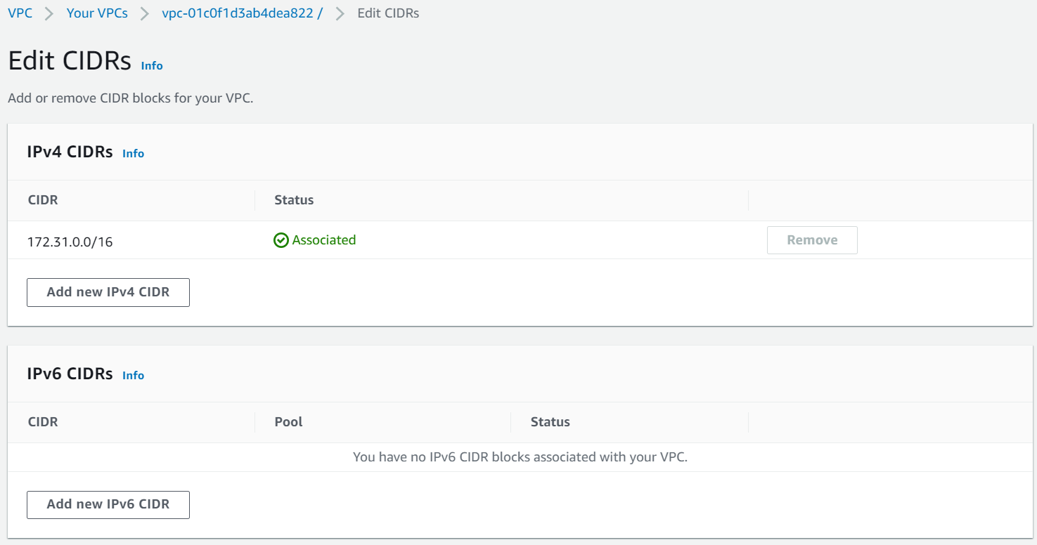
VPC Service
Netmask:
Max: /16 netmask (65,536 address), Min: /28 netmask (16 address)
Defines how many bits can change in the IP
/8 🡺 255.0.0.0, /16 🡺 255.255.0.0, /24 🡺 255.255.255.0, /32 🡺 255.255.255.255
Ex: 192.168.0.0/24 = 192.168.0.0 – 192.168.0.255 (256 IPs)
0.0.0.0/0 = All IPs!
Automatically redistribute IP range
Ex: 192.68.0.18/18 🡺 192.68.0.0/18
CIDR block in VPC do not overlap, cannot resize

Slide 27
VPC Service
Subnet
Split 1 VPC into many subnets (local network)
Usecases
Group of instances with the same security, same function, …
Ex: The company's local network will be divided into many different departments
Using IP in subnet to assign resources or applications such as: Web, application, database, ... in a single VPC
Add subnet to VPC

Slide 28
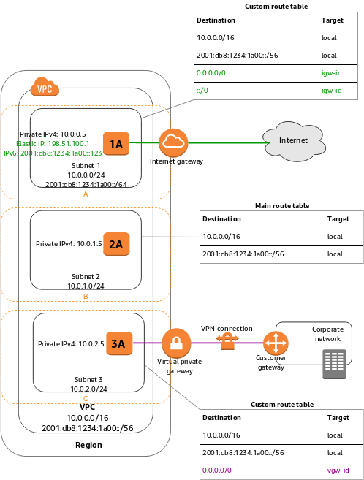
VPC Service
Types
Public subnet: connect to internet via the internet gateway
Private subnet: cannot connect to internet
VPN-only subnet: connect to home network via VPN
Contain at least a CIDR Block (a range of private Ips for instances into subnet)
Default: Ipv4
Each subnet is in 1 zone 🡺 2 subnets in 2 zones cannot communicate with each other
Subnet 1 - Public subnet
Subnet 2 - Private subnet
Subnet 3 - VPN-only subnet

Slide 29
VPC Service
AWS reserves 5 IP addresses (first 4 & last 1) in each subnet 🡺 5 IP addresses are not available for use and can’t be assigned to an EC2 instance
Exam Tip, if you need 29 IP addresses for EC2 instances:
You can’t choose a subnet of size /27 (32 IP addresses, 32 – 5 = 27 < 29)
You need to choose a subnet of size /26 (64 IP addresses, 64 – 5 = 59 > 29)
10.0.0.0: Network address
10.0.0.1: VPC router
10.0.0.2: DNS server
10.0.0.3: future function of AWS
10.0.0.255: Network broadcast address

Slide 30
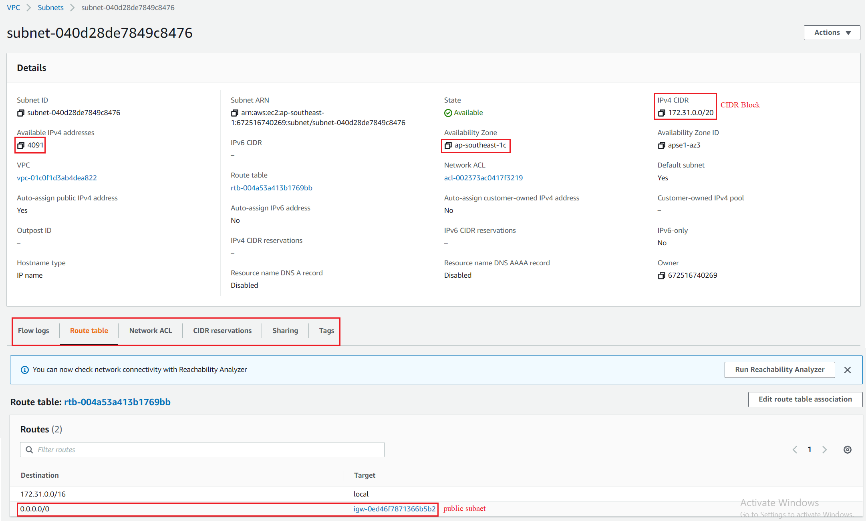
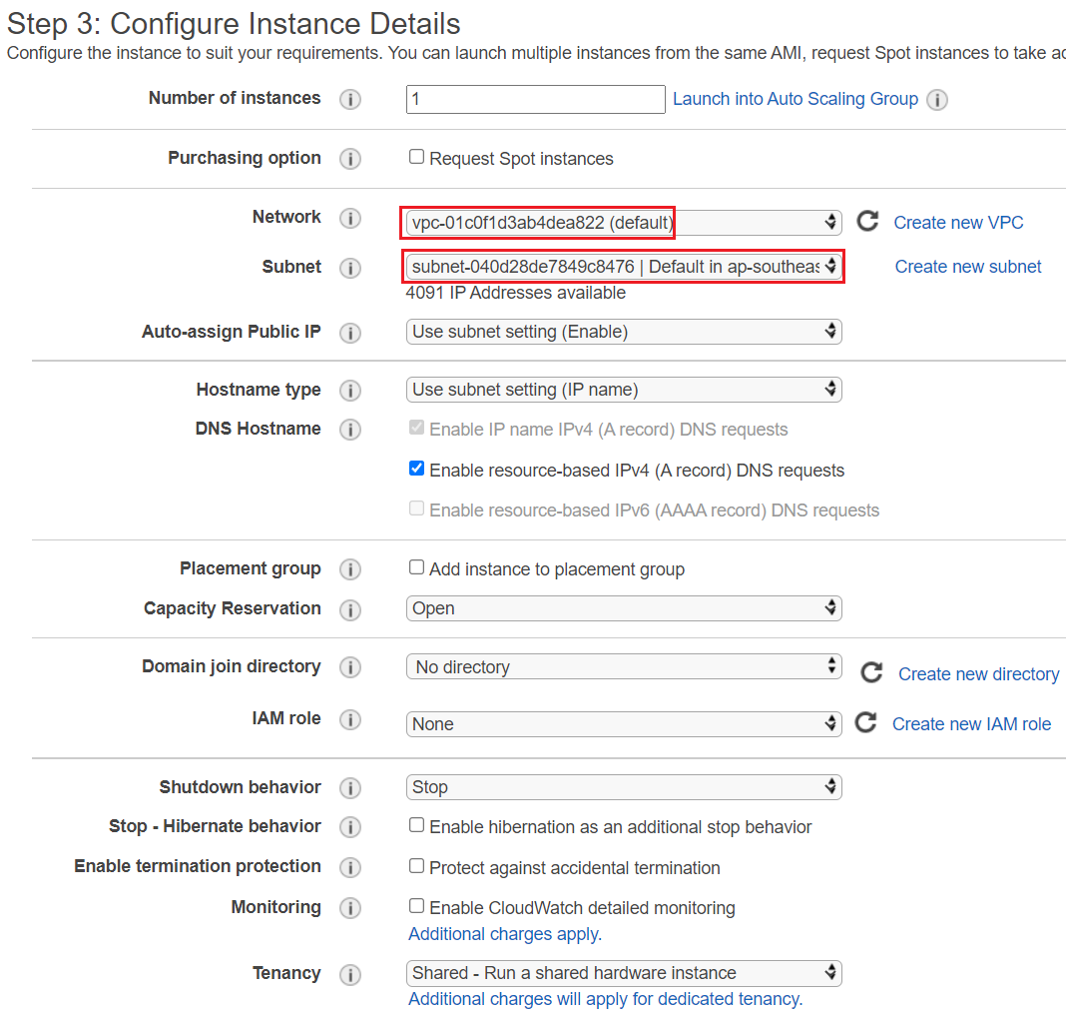
VPC Service
Components
Specify subnet for instance

Slide 31

VPC Service
Route table
Including a list of rules (routes) to route traffic for each subnet
Each subnet has 1 route table, 1 route table can be associated with many subnets
2 types:
Main Route table (default route table)
Automatically attach to all subnets that are not linked to a specific custom route table
Custom route table
Link to a specific subnet

Slide 32









VPC Service
Internet Gateway
NAT Gateway
Virtual private gateway
Peering connection
PrivateLink & VPC endpoint

Slide 33


VPC Service
DHCP
Stands for Dynamic Host Configuration Protocol
Using to config host on the network
DHCP
EC2

Slide 34

VPC Service
NACL
Stands for Network access control list
Define rules for inbound traffic & outbound traffic entering the subnet
Similar to firewall which control traffic from and to subnets
One NACL per subnet
Apply for all instances within the subnet
Can be attached to multiple subnets
Usecases: block a specific IP address at the subnet level

Slide 35


VPC Service
Default: allow all inbound traffic & allow all outbound traffic
Stateless: config inbound and outbound traffic independently

Slide 36

VPC Service
Rules have a number (1-32766), higher precedence with a lower number & First rule match will drive the decision
Ex: if you define #100 ALLOW 10.0.0.10/32 and #200 DENY 10.0.0.10/32, the IP address will be allowed because 100 has a higher precedence over 200
https://docs.aws.amazon.com/vpc/latest/userguide/vpc-network-acls.html#nacl-tasks

Slide 37


VPC Service
Security group & NACL Comparing

Slide 38
Assignment
Self-practice

Slide 39


VPC Service
Internet Gateway
Allow resources in the VPC to communicate with the internet (Instances still need public Ipv4 to access the internet)
It scales horizontally and is highly available and redundant
https://docs.aws.amazon.com/vpc/latest/userguide/VPC_Internet_Gateway.html#working-with-igw
You must edit route tables of VPC

Slide 40
VPC Service
NAT
Stands for Network Address Translation
Allow instances in private subnet to access internet (traffic outbound via public IPv4 or Elastic IP)
From the internet can't access the instance
Instances with private IP will use public IP of NAT and access internet via internet gateway
2 types
NAT Instance (NAT Device) (outdated)
NAT Gateway (Recommended)

Slide 41

VPC Service
NAT instance (NAT Device) (outdated)
Is a linux instance, you have to manually launch and manage
Must be in public subnet & have Elastic IP
NAT instance uses internet gateway
Instance in private subnet will use NAT gateway
Internet traffic bandwidth depends on EC2 instance type
Not highly available
Price: based on type instance
Tutorial: https://docs.aws.amazon.com/vpc/latest/userguide/VPC_NAT_Instance.html#NATInstance

Slide 42

VPC Service
NAT Gateway (Recommended)
AWS-managed NAT, do not set up anything
Higher bandwidth, high availability, no administration
Traffic bandwidth: 5 Gbps 🡺 45 Gbps
Automatic assigning public IP
Price: more expensive - Pay per hour for usage and bandwidth
Tutorial: https://docs.aws.amazon.com/vpc/latest/userguide/vpc-nat-gateway.html#nat-gateway-working-with

Slide 43

VPC Service
Can setup multiple NAT gateways on multiple zones (High Availability)

Slide 44

VPC Service
Comparing
https://docs.aws.amazon.com/vpc/latest/userguide/vpc-nat-comparison.html

Slide 45


VPC Service
Egress-only internet gateway
Allow instance in private subnet to access internet (traffic outbound via IPv6)
Similar to a NAT Gateway but for IPv6
Routing
Tutorial

Slide 46
Assignment
Self-practice

Slide 47

VPC Service
Bastion host (Jump boxes)
Is a linux instance in front of the private subnet, it helps to securely connect SSH to the instances in the private subnet 🡺 Minimizing attacks from outside
Bastion host must be in public subnet which is then connected to all other private subnets
Bastion Host security group must be tightened (Usually only a few IPs accessing, do not open the internet)
Exam Tip: Make sure the bastion host only has port 22 traffic from the IP address you need

Slide 48

VPC Service
Can use NAT Instance as a bastion host
NAT is for outbound traffic and Bastion host is for filtering inbound traffic
SSH Agent Forwarding helps to connect SSH from internet to private instance via bastion host without putting private key on bastion host
Tutorial: https://aws-quickstart.github.io/quickstart-linux-bastion/#_linux_bastion_hosts_on_aws

Slide 49

VPC Service
Session Manager
Is a feature of System Manager
Manage user access to the instance, using IAM policy
Do not open inbound port, manage SSH key, bastion host
Support Windows, Linux, MacOS
Tutorial: https://www.youtube.com/watch?v=GdE_ke25e5o
https://docs.aws.amazon.com/systems-manager/latest/userguide/session-manager-getting-started.html

Slide 50
Assignment
Self-practice

Slide 51


VPC Service
VPC Peering Connection
To connect between VPCs via a private path in AWS, make them behave as if they were in the same network
Instances in VPCs can communicate with each other
You can peer 2 VPCs, 2 subnets, 2 instances
You can create VPC Peering connection between VPCs in different AWS accounts/regions
When going through regions the data will be encrypted and go through AWS's private network

Slide 52


VPC Service
Not support transitive peering (must be established for each VPC that need to communicate with one another)
Must not have overlapping CIDRs
Only support Ipv4
VPC B cannot connect to VPC C
VPC B can connect to VPC C

Slide 53

VPC Service
Price
If 2 VPCs are in the same region 🡺 cross-region prices will apply
If 2 VPCs are in different regions, inter-region prices will apply
https://aws.amazon.com/ec2/pricing/on-demand/#Data_Transfer
Usecases
Peering multiple VPCs to provide full resource access
Ex: The company divides each department using 1 VPC (may be different accounts) and departments can access each other's resources
Create a centralized VPC to access other VPC resources
Instances in different regions can communicate via private IP
Centralized VPC

Slide 54

VPC Service
Exposing services in your VPC to other VPC

Slide 55


VPC Service
Config
2 VPC peering: Video Tutorial, Link Tutorial
Multiple VPC peering:

Slide 56



VPC Service
Can be combined with VPN, internet gateway, VPC Endpoint, ...
Tutorial: https://docs.aws.amazon.com/vpc/latest/peering/peering-configurations-full-access.html

Slide 57



VPC Service
Subnet, instance peering
Subnet
Instance
Tutorial: https://docs.aws.amazon.com/vpc/latest/peering/peering-configurations-partial-access.html
ClassicLink: Using for EC2-Classic
Tutorial: https://docs.aws.amazon.com/vpc/latest/peering/peering-configurations-classiclink.html

Slide 58
VPC Service
PrivateLink
To connect between services via a private path (Using private Ipv4) instead of public internet
Services can be VPC or AWS service on other account, other region, AWS partner
If there are the internet gateway and the PrivateLink, then traffic in same regions will go through PrivateLink and traffic in other regions will go through the internet gateway
Not support Ipv6
Regional resource
Price: cheaper than internet cost - https://aws.amazon.com/privatelink/pricing

Slide 59

VPC Service
The instance in subnet 1 can connect to Kinesis via public Ipv4 & internet gateway (expensive)
Instances in each subnet can connect to Kinesis via endpoint (cheap, secure)

Slide 60

VPC Service
Components
VPC endpoint
Service

Slide 61
VPC Service
VPC endpoint
Is a virtual device
3 types
Interface endpoint
Gateway endpoint
Gateway Load Balancer endpoint

Slide 62

VPC Service
Interface endpoint
Provide private Ipv4, private DNS, endpoint hostname for VPC to communicate with services
Instances in each subnet can connect to Kinesis via endpoint interface using private Ipv4, private DNS, enpoint hostname

Slide 63


VPC Service
Only support VPC to Service (not support 2 VPCs or 2 Services)
Bandwidth: 10 Gbps 🡺 40 Gbps
Using HTTPs (port 443) – TCP
Supported services: AWS Service, AWS partner service, custom service (Application in VPC)
Support most AWS services
Endpoint service
Tutorial: https://youtu.be/zlFmrT2Do74
https://docs.aws.amazon.com/vpc/latest/privatelink/vpce-interface.html#create-interface-endpoint

Slide 64

VPC Service
Gateway endpoint
Allow attaching services to the gateway in PVC (use directly, no need to connect via IP)
Only supported services: S3, DynamoDB
Not support VPC peering
Only support VPC to Service (not support 2 VPCs or 2 Services)
Tutorial: https://www.youtube.com/watch?v=m8OZRZGfrFg
https://docs.aws.amazon.com/vpc/latest/privatelink/vpce-gateway.html#create-gateway-endpoint

Slide 65

VPC Service
Gateway Load Balancer endpoint
Using for load balancing
Tutorial: https://docs.aws.amazon.com/vpc/latest/privatelink/vpce-gateway-load-balancer.html#create-gwlbe

Slide 66
Assignment
Self-practice

Slide 67

VPC Service
VPN
Connect home network (on-premises) to private subnet in VPC via VPN connection over public internet
2 types:
Site-to-site VPN
Client VPN
Price: https://aws.amazon.com/vpn/pricing
https://docs.aws.amazon.com/vpn/index.html

Slide 68

VPC Service
Site-to-site VPN
2 or more different IP ranges can communicate with each other
Data is encrypt before sending through public internet
Bandwidth: max 1,25 GB, unstable
Usecases
The department connects to AWS services

Slide 69
VPC Service
Components
VPN Connection
VPN tunnel
Customer gateway & Customer gateway device
Virtual private gateway / Transit gateway
VPN CloudHub

Slide 70

VPC Service
VPN tunnel
Is encrypted connection between customer network and AWS
Each VPN Connection has 2 tunnels
VPN tunnel

Slide 71

VPC Service
Customer gateway
Is an AWS resource that provides information about the customer gateway device
Software application or physical device on customer side of the VPN connection
Customer gateway device
Is a hardware device or application placed on the customer side
Must have public static IP
Support Internet Protocol security (Ipsec)
Customer gateway device

Slide 72


VPC Service
Virtual private gateway / Transit gateway
VPN concentrator on the AWS side
Only support IPv4
Must have public static IPv4
Only 1 VPC connection is supported
Virtual private gateway
Transit gateway

Slide 73

VPC Service
VPN CloudHub
Provide secure communication between multiple sites, if you have multiple VPN connections

Slide 74




VPC Service
Architecture
Single VPN connection
Multiple VPN connection
VPN Connection & Direct Connect
VPN Connection & VPC Endpoint

Slide 75
VPC Service
Best practices
All traffic from other aws services or the internet that wants to access the private subnet must go through the virtual private gateway (the traffic accessing the public subnet through the internet gateway)
You can setup NAT + Virtual private gateway to the instance in the private subnet can access the internet but only the home network can access the instance
Tutorial
https://www.youtube.com/watch?v=5YvcyBecQts
https://docs.aws.amazon.com/vpn/latest/s2svpn/SetUpVPNConnections.html

Slide 76

VPC Service
Client VPN
Allow access to resources on AWS from home network using OpenVPN-based VPN application
2 roles:
Admin: Setup & config VPN
User: Access via OpenVPN-based VPN client application
Usecases
The individual connects to AWS services

Slide 77
VPC Service
Components
Client VPN endpoint
Target network
Client
VPN client application

Slide 78
VPC Service
Client VPN endpoint
Is resource in AWS
The admin create and configure Client VPN endpoints through file configuration
Target network
Is a network VPC of Client VPN endpoint
Client
Is end user connecting to Client VPN endpoint via VPN Connection
User will download OpenVPN software and use Client VPN configuration to create VPN Connection

Slide 79



VPC Service
Architecture
Single VPC
VPC Peering
Site-to-site VPN

Slide 80

VPC Service
Internet gateway
Client-to-client
https://docs.aws.amazon.com/vpn/latest/clientvpn-admin/scenario.html

Slide 81

VPC Service
Tutorial
https://www.youtube.com/watch?v=Bv70DoHDDCY
Admin, User

Slide 82

VPC Service
Direct Connect (DX)
Is a network service, provide a dedicated, stable optical fiber line to connect on-premises servers to AWS services via Direct Connect Location
Using instead of internet to connect from on-premises to AWS service
https://docs.aws.amazon.com/directconnect/latest/UserGuide/Welcome.html

Slide 83
VPC Service
Do not use internet connection 🡺 using a private line
High speed, high stability (10 Gbps 🡺 100 Gbps)
Complicated setup, usually use a VPN line for backup (VPN using internet connection )
Price: expensive - https://aws.amazon.com/directconnect/pricing
Usecases
Enterprice has a large amount of data and which often transfer between on-premises and AWS (Ex: bank, ...)
Connection to AWS requires high throughput, low latency, real-time
Hybrid environment

Slide 84
VPC Service
Components
Direct Connect Location
Direct Connect Connection
LAG
Virtual interface
Direct connection gateway
Tutorial: https://www.youtube.com/watch?v=mj5V3_-QEW0

Slide 85
VPC Service
Direct Connect Location
Including: customer or partner router, endpoint (endpoint connect to Private Virtual Interface via VPN)
Each region has 1 location
Direct Connect Connection
Is the physical connection between the customer to a Direct Connect Location
2 types
Dedicated Connection: for single customer, port speed (1 Gbps, 10 Gbps, and 100 Gbps)
Hosted Connection: for partner, port speed (50 Mbps, 100 Mbps, 200 Mbps, 300 Mbps, 400 Mbps, ..., 5 Gbps, and 10 Gbps)
List AWS Partner in Vietnam: https://partners.amazonaws.com/search/partners/?loc=Vietnam&page=1

Slide 86

VPC Service
LAG
Stands for Link aggregation group
Is a logical interface to group connections associated with a Direct Connect Endpoint (Using for backup)

Slide 87
VPC Service
Virtual interface
Endpoint which use to connect between Direct Connect Endpoint to VPC or AWS Services
4 types:
Public virtual interface & Border Gateway Protocol (BGP): Accessing public AWS service via public IP
Private virtual interface: Accessing VPC via private IP
Transit virtual interface: Accessing VPC Transit gateway
Hosted virtual interface: Accessing Direct Connect of other account

Slide 88


VPC Service
Direct connection gateway
Is a group of virtual gateways (VPC) to connect to a virtual interface
Support cross-accounts, cross-regions
Connect to multiple VPCs
Connect to multiple accounts

Slide 89
Assignment
Self-practice

Slide 90
VPC Service
Transit gateway
Manage multiple connections, working similar Centralized Virtual Router
You can connect peer between thousands of VPC and on-premises
Is a network transit hub in AWS
Regional resource, support cross-regions, cross-accounts

Slide 91


VPC Service
Complicated
Centralized router
https://docs.aws.amazon.com/vpc/latest/tgw/what-is-transit-gateway.html

Slide 92



VPC Service
Usecases
Peering transit gateway
Centralized router
Centralized outbound routing

Slide 93


VPC Service
Share Direct Connect between multiple accounts
Appliance in a shared services VPC

Slide 94


VPC Service
Create multiple Site-to-Site VPN connections to increase the bandwidth of your connection to AWS
https://docs.aws.amazon.com/vpc/latest/tgw/TGW_Scenarios.html

Slide 95


VPC Service
Demo
https://www.youtube.com/watch?v=E5HpOVKNpug
https://docs.aws.amazon.com/vpc/latest/tgw/tgw-getting-started.html
Without Transit Gateway
With Transit Gateway

Slide 96

VPC Service
RAM
Allow sharing resources between Organizations, Organization Units, Accounts, IAM Users, Roles
Price: free
https://docs.aws.amazon.com/ram/latest/userguide/what-is.html

Slide 97

VPC Service
Supported resource types
Demo
https://www.youtube.com/watch?v=KL9SICG52zY
https://docs.aws.amazon.com/ram/latest/userguide/getting-started.html

Slide 98
Assignment
Self-practice

Slide 99


VPC Service
Global Accelerator
Is network service, Allows creating accelerators to increase availability and performance when accessing your server from around the world (via edge location)
https://docs.aws.amazon.com/global-accelerator/latest/dg/what-is-global-accelerator.html

Slide 100


VPC Service
Data from edge location to AWS will follow AWS private global network
Only support Ipv4
Up to 60% performance increase
Without AWS Global Accelerator
With AWS Global Accelerator
Tool for testing: https://speedtest.globalaccelerator.aws
Price: https://aws.amazon.com/global-accelerator/pricing

Slide 101

VPC Service
Usecases
App run in multiple regions
Gaming
Real-time communication …
Demo
https://www.youtube.com/watch?v=Docl4julOQw

Slide 102

VPC Service
Components
Accelerator
Listener
Endpoint group
Endpoint

Slide 103
VPC Service
Accelerator
Redirect traffic to endpoint via AWS Global Network
2 types
Standard accelerator
Automatically redirect traffic to the endpoint in the region that best matches the request (based on endpoint health, user location, policy, ...)
Custom routing accelerator
Route multiple users to specific EC2 instance destinations in VPC subnets

Slide 104

VPC Service
Accessing via Static IP, DNS name (Recommended)

Slide 105

VPC Service
Listener
Handle inbound traffic from client to endpoint base on port & protocol
Client affinity: when a request comes from the same IP, it will always be forwarded to the same endpoint

Slide 106

VPC Service
Endpoint group
Including endpoints
Traffic dial: with the standard accelerator you can specify the percentage of traffic that will redirect to the endpoint group
Health checks: check endpoint is working

Slide 107

VPC Service
Endpoint
Types: Network load balancer, Application load balancer, EC2, Elastic IP, ... In different regions

Slide 108
VPC Service
Other config
Custom routing accelerator: Link
Tutorial

Slide 109
Assignment
Self-practice

Slide 110

VPC Service
Flow logs
Allow capture information about IP traffic in VPC
Publish in CloudWatch, S3
Support query in Flow logs (Using Athena)
Price: cheap
https://docs.aws.amazon.com/vpc/latest/userguide/flow-logs.html

Slide 111

VPC Service
Syntax
srcaddr & dstaddr – help identify problematic IP
srcport & dstport – help identity problematic ports
Action
Success or failure of the request due to Security Group / NACL
Can be used for analytics on usage patterns, or malicious behavior
https://docs.aws.amazon.com/vpc/latest/userguide/flow-logs-records-examples.html

Slide 112

VPC Service

Slide 113

VPC Service
Troubleshoot SG & NACL issues
Tutorial
https://www.youtube.com/watch?v=TzwrVF-45t0
Query: https://docs.aws.amazon.com/vpc/latest/userguide/flow-logs-athena.html

Slide 114
VPC Service
Reachability Analyzer
A network diagnostics tool that troubleshoots network connectivity between two endpoints in your VPCs
It builds a model of the network configuration, then checks the reachability based on these configurations (it doesn’t send packets)
2 Status
Reachable: it produces hop-by-hop details of the virtual network path
Not reachable: it identifies the blocking component(s) (e.g., configuration issues in SGs, NACLs, Route Tables, …)
Usecases
Troubleshoot connectivity issues, ensure network configuration is as intended, …

Slide 115

VPC Service
Demo: https://www.youtube.com/watch?v=Ks59Fff-q3g

Slide 116
Assignment
Self-practice

Slide 117

VPC Service
Network Cost

Slide 118

VPC Service
Network Cost
Best practices
Use Private IP instead of Public IP for good savings and better network performance
Use same region for maximum savings

Slide 119

VPC Service
Egress traffic: outbound traffic (from AWS to outside)
Ingress traffic: inbound traffic - from outside to AWS (typically free)
Try to keep as much internet traffic within AWS to minimize costs

Slide 120


VPC Service
Example

Slide 121
Summary
Ipv4 & Ipv6
VPC: Virtual Private Cloud, network service, we define a list of IPv4 & IPv6 CIDR Ipv4 & Ipv6
CIDR: IP Range
Subnets: tied to an AZ, we define a CIDR
Route Tables: must be edited to add routes from subnets to the IGW, Peering Connections, ...
NACL: stateless, subnet level
Security Groups: stateful, EC2 instance level
Internet Gateway: VPC level, allow resources accessing Internet

Slide 122
Summary
NAT Instances: gives Internet access to EC2 instances in private subnets. Outdated
NAT Gateway: managed by AWS, provides scalable Internet access to private EC2 instances, IPv4 only
Egress-only Internet Gateway: like a NAT Gateway, but for IPv6
Bastion Host: Is a public EC2 instance to SSH into EC2 instances in private subnets
Session Manager: SSH to EC2 instances without open inbound port, manage SSH key, bastion host
VPC Peering: connect two VPCs with non overlapping CIDR, non-transitive
PrivateLink: To connect between VPC and AWS services via a private path, only support Ipv4
Gateway endpoint: attach service to gateway VPC, only support S3, DynamoDB

Slide 123
Summary
VPN: Connect home network to private subnet in VPC via VPN connection over public internet
Site-to-Site VPN: 2 or more different IP ranges can communicate with each other
Client VPN: Allow individuals from home network access to resources on AWS using OpenVPN app
VPN CloudHub: hub-and-spoke VPN model to connect your sites
Direct Connect: provide a dedicated, stable optical fiber line to connect on-premises to AWS
Transit Gateway: Centralized Virtual Router, support cross-regions, cross-accounts
RAM: Allow sharing resources between Organizations, Organization Units, Accounts, IAM Users, Roles
Global Accelerator: Allows creating accelerators to increase availability and performance when accessing your server from around the world (via edge location)

Slide 124
Summary
Flow logs: capture information about IP traffic in VPC, publish in CloudWatch, S3 Support query (Athena)
Reachability Analyzer: perform network connectivity testing between AWS resources

Slide 125
Assignment

Slide 126
Quiz

Slide 127
Reference
https://docs.aws.amazon.com/

Slide 128
Q & A
Copyright © VTI Academy All Rights Reserved

